Slide 1
Max Flow
Scott Nelson

Slide 2
Problem

Slide 3
What is Max Flow
Graph Problem maximizing flow across a network
Weighted Graph, Source, and Sink
Goal of pushing most “flow” across network
Weights of edges are capacity
Balance of flow for intermediate nodes must be zero
Flow in = Flow out

Slide 4
Applications of Max Flow Problems
Train Networks
Maximize the amount of trains from point A->B
Only can send so many trains on tracks for connecting routes between A and B
Computer Networks
Maximize the data flow across a network
Each server can only process so much data
Airline Scheduling
Flights departing from Los Angeles flying to London
Airports can only have so many flights a day
Connecting flights vs Direct

Slide 5
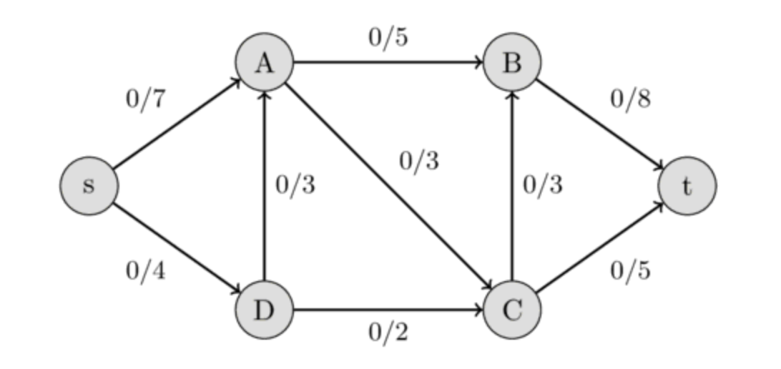
Example Network

Slide 6
Algorithms

Slide 7
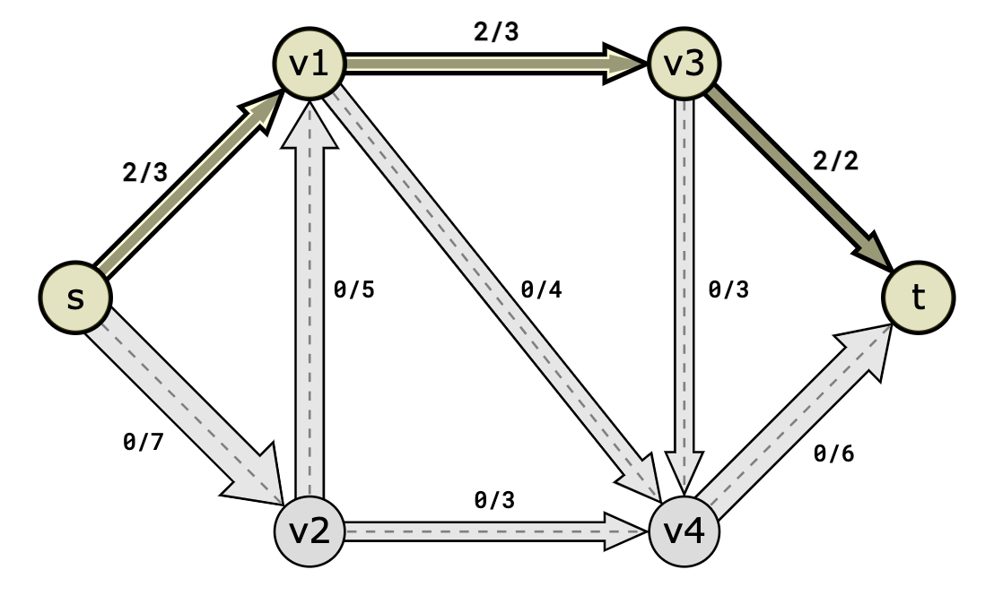
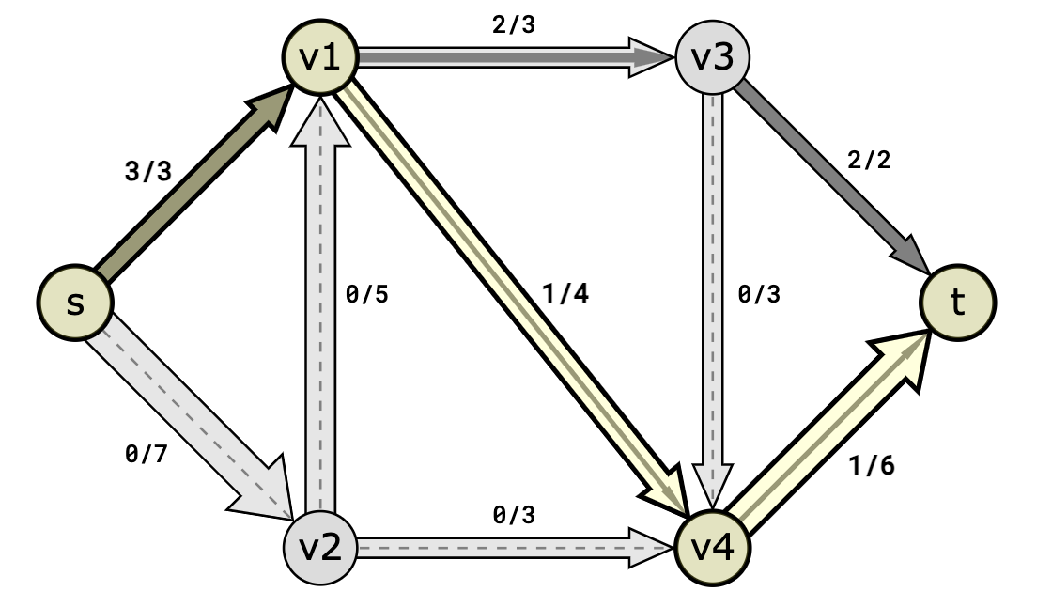
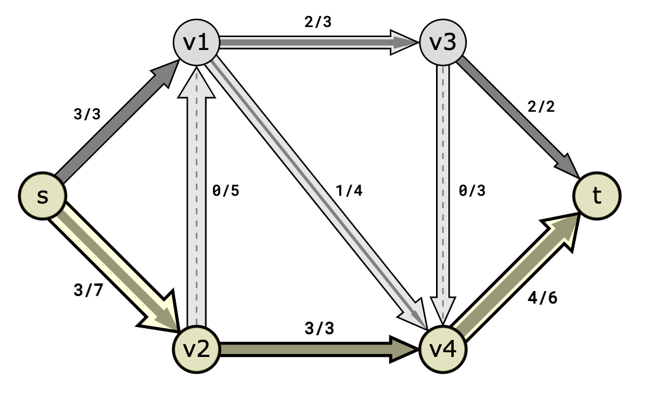
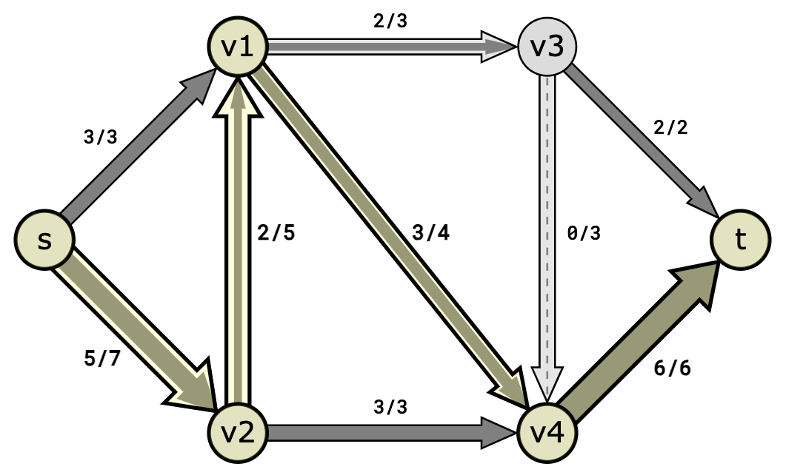
Edmond Karp Algorithm
Loops through potential paths from source to sink
Starts with shortest augmenting paths using Breadth First Search
Augmenting paths are paths from source to sink with capacity allowing more flow
Calculate bottleneck value for augmenting path
Repeat until no more augmenting paths can be found
Use edges flowing out of source or into sink to calculate max flow graph of augmenting paths

Slide 8
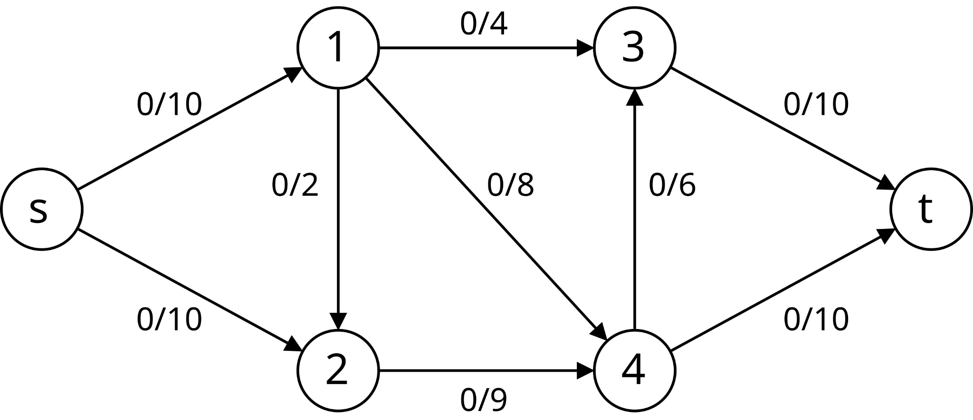
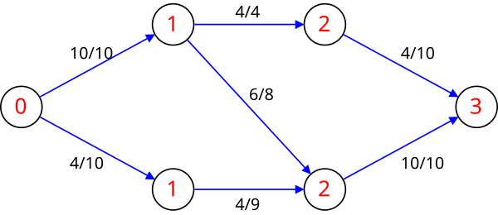
Dinic’s Algorithm
Similar to Edmond Karps as it uses shortest augmenting path
Focuses on creating a level graph (assigning level to each vertex)
Level value of vertex represents shortest path to source along edges with capacity remaining
Only send from level i to level i+1
Repeat until blocking flow is reached
Blocking flow is when edge in path has reached capacity so no flow can be sent even if later edges have extra capacity

Slide 9
Linear Programming
Max Flow problem can be rewritten into LP problems
A: Identity Matrix for number of edges in graph
b: Capacity Constraint for each edge
Aeq: Equations of inflow edges - outflow edges on intermediary nodes in the network
Beq: Zeros as inflow - outflow of intermediary nodes must sum to zero
c: Objective function usually uses either the outflow of source node or inflow to sink node
After constructing the matrices can simply use Simplex method to find the optimal solution

Slide 10
Results

Slide 11
Testing
Used Matlab timer for performance comparison
Dinic’s Algorithm was consistently most performant
Edmond Karp’s was almost as fast as Dinic’s and could have been error or test cases favoring Dinic’s
Linear Programming was significantly slower than other algorithms
Testing results make sense
Dinic’s BigO is O(V^2E)
Edmond Karp’s BigO is O(VE^2)
Most graphs tend to have more edges than nodes favoring Dinic’s on average

Slide 12
Conclusion
Linear Programming functioned as an effective solver for max flow, but is outperformed by more modern algorithms
Dinic’s Algorithm will typically be more effective due to it favoring more edges than vertices
Edmond Karp’s can be as effective as Dinic’s but it’s rare
Overall all algorithms could be reasonable used in an industry use case
LP is not so much slower than the other two to cause challenges

Slide 13
Further Improvements
Test more implementations of LP for greater comparison
Use more efficient algorithms than Edmond Karp and Dinic
Neither of these algorithms are “true” industry standards
Compare Max Flow implementation to Min Cut implementation
Proofs have shown each instance of Max Flow can be implemented as a Min Cut Problem

Slide 14
References
-https://www.cs.cornell.edu/courses/cs4820/2012sp/handouts/edmondskarp.pdf
- https://www.cs.cmu.edu/~15451-s22/lectures/lec11-dinics-optional.pdf
- Course Slides were used to derive simplex algorithm, credit to Professor Brorson

